Slide 1
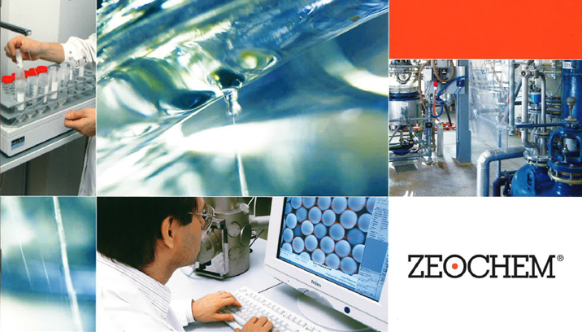
Chemistry. Pure. Efficient.
A company of CPH Chemie + Papier Holding AG
ZEOsphere CN Specifications
Zeochem
A leader in silicate chemistry
Classic reversed phase material based on 100Å Ultra-pure silica with high surface area. Cyano phases are produced by bonding a cyanopropyl silane to the silica. This results in a column that has some polar functionality due to the CN group and some nonpolar functionality due to the propyl group. Thus, the column has intermediate polarity and is suitable for use in both the normal-phase and the reversed-phase modes. In the reversed phase mode, the column is less retentive than a C8 column and somewhat similar in polarity to a C3 column for the retention of neutral compounds. This makes the column ideal for situations where there is too much retention using a C8 column.
In the normal-phase mode, the cyano column is a less active polar phase than silica, which gives the user more flexibility in separation development. When silica is used in the normal-phase mode, the preparation of the mobile phases must be carefully carried out to preserve the "activity" of the column.
Common applications based on Cyano phases include the separation of flavonoids, extraction of polar compounds from non-polar samples as well as analytes with a wide range of hydrophobicity.
Bonded ZEOsphere products are consistently produced and controlled according to quality standard ISO-9001. Strict QC controls from raw material to finished product
ensure high lot-to-lot reproducibility and tightly controlled specifications.
ZEOsphere silicas are available in different quantities with a wide variety of packing sizes to meet individual applications and economic requirements.

