Slide 1
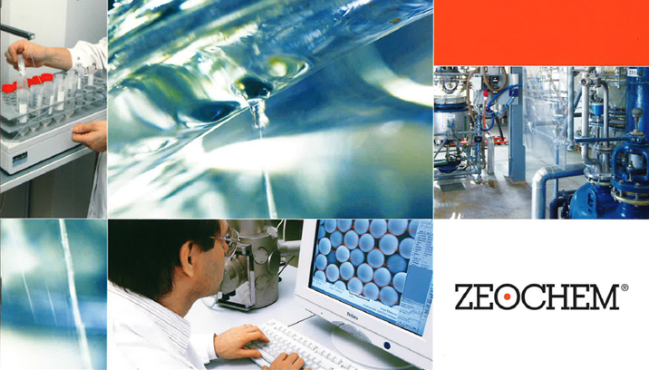
Chemistry. Pure. Efficient.
A company of CPH Chemie + Papier Holding AG
ZEOsphere C8 Specifications
Zeochem
A leader in silicate chemistry
Classic reversed phase material based on 100 Å,120Å and 300Å Ultra-pure silica with an excellent surface area and available in multiple particle sizes. C8 is for reversed-phase separation of analytes with moderate hydrophobicity. This high-performance stationary phase provides selectivity with a predictable elution order as ZEOsphere C18 but less retention. Compounds elute more quickly, yielding faster separations. The unique chemistry of bonded C8 ligands on ZEOsphere C8 phases provide exceptional performance for a variety of analytical and preparative applications in the (bio) pharmaceutical, nutraceutical, chemical and other chromatographic related industries.
Bonded ZEOsphere products are consistently produced and controlled according to quality standard ISO-9001. Strict QC controls from raw material to finished product ensure high lot-to-lot reproducibility and tightly controlled specifications.
ZEOsphere silicas are available in different quantities with a wide variety of packing sizes to meet individual applications and economic requirements.

