Slide 1
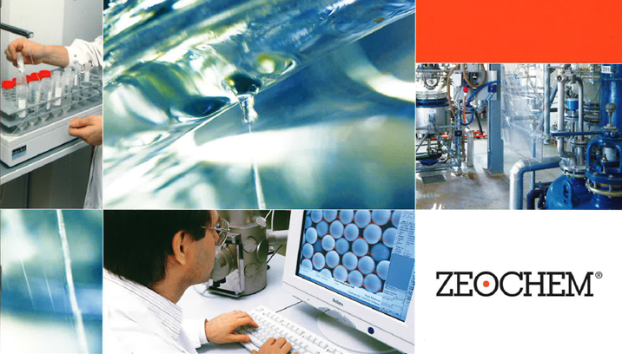
Chemistry. Pure. Efficient.
A company of CPH Chemie + Papier Holding AG
ZEOsphere C4 Specifications
Zeochem
A leader in silicate chemistry
ZEOsphere C4 phases are based on 300Å Ultra-pure silica with an excellent surface area and available in multiple particle sizes. C4 phases are designed for the separation of biological macromolecules which are too large or too hydrophobic for separations based on phases with smaller pores and or longer alkyl chain bonded phases. ZEOsphere 300 C4 give excellent peak shape, high efficiency and excellent recovery.
Bonded ZEOsphere products are consistently produced and controlled according to quality standard ISO-9001. Strict QC controls from raw material to finished product ensure high lot-to-lot reproducibility and tightly controlled specifications.
ZEOsphere silicas are available in different quantities with a wide variety of packing sizes to meet individual applications and economic requirements.

