Slide 1
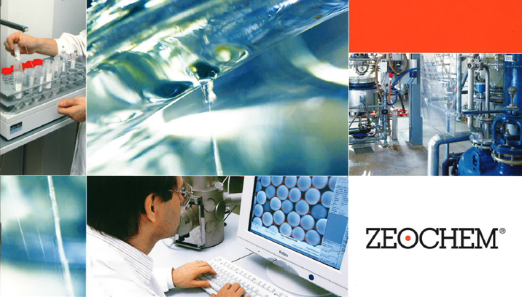
Chemistry. Pure. Efficient.
A company of CPH Chemie + Papier Holding AG
ZEOsphere C18 Specifications
Zeochem
A leader in silicate chemistry
Classic reversed phase material, based on 100 Å,120Å, 200Å and 300Å Ultra-pure silica with an excellent surface area and available in multiple particle sizes. C18 is most retentive for a wide range of acidic, basic and chelating compounds. ZEOsphere C18 provide exceptional performance for a variety of analytical and preparative applications in the (bio) pharmaceutical, nutraceutical, chemical and other chromatographic related industries.
Bonded ZEOsphere products are consistently produced and controlled according to quality standard ISO-9001. Strict QC controls from raw material to finished product ensure high lot-to-lot reproducibility and tightly controlled specifications.
ZEOsphere silicas are available in different quantities with a wide variety of packing sizes to meet individual applications and economic requirements.

