Slide 1
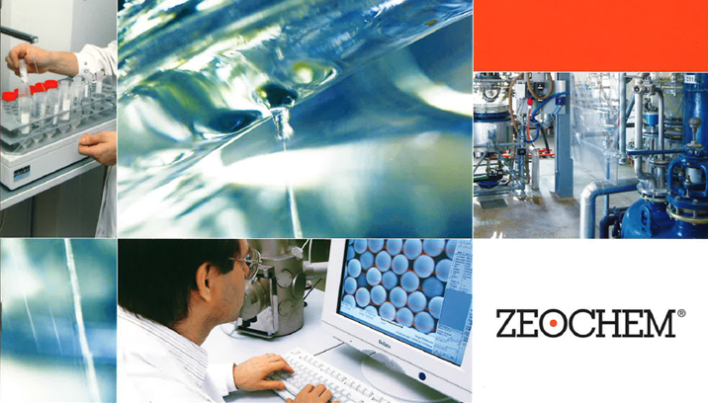
Chemistry. Pure. Efficient.
A company of CPH Chemie + Papier Holding AG
ZEOsphere Phenyl & Derivatives Specifications
Zeochem
A leader in silicate chemistry
Classic reversed phase material based on 120Å Ultra-pure silica with high surface area. ZEOsphere Phenyl as reverse phase or in HILIC mode shows alternative selectivity to C18 and C8 columns. The phenyl group provides the stationary phase with a moderate degree of hydrophobicity, making it ideal for the separation of analyte mixtures with varying polarity and aromaticity. Key Applications: small, water soluble molecules and peptides, π-acceptors, nitroaromatics, polar compounds, dipoles, heterocyclics, HILIC mode.
Also available: 100Å Phenyl, Phenyl-Hexyl and Phenyl-Butyl.
Phenyl-Hexyl:
Phenyl-Hexyl offers a unique selectivity for the separation of compounds that are difficult to resolve using traditional phenyl phases. Phenyl-Hexyl is especially effective for resolving aromatic hydrocarbons such as in peptides, tricyclic antidepressants and explosives. Like C18, Phenyl-Hexyl is ideal for a wide range of applications, including the resolution of moderate hydrophobic compounds.
Phenyl-Butyl:
Phenyl-Butyl bonded phase. Alternative for standard phenyl for analytes with aromatic rings or long conjugated systems tend to have strong retention. ZEOsphere Phenyl-Butyl is ideal for the separation of isomers or structural analogues.
Bonded ZEOsphere products are consistently produced and controlled according to quality standard ISO-9001. Strict QC controls from raw material to finished product ensure high lot-to-lot reproducibility and tightly controlled specifications.
ZEOsphere silicas are available in different quantities with a wide variety of packing sizes to meet individual applications and economic requirements.

